Slide 1
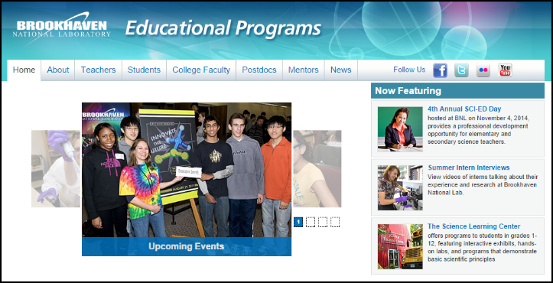
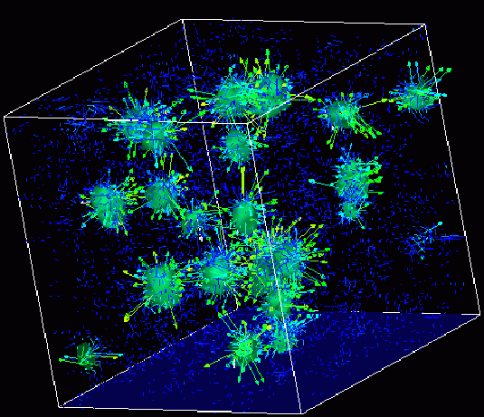

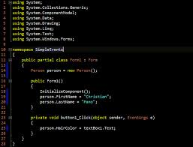
Survey of
Scientific Computing
(SciComp)
Unit 1
Course Overview,
Hello Problems

Slide 2



Welcome!
My name is Dave Biersach
I am a Technology Architect at BNL
I am a 1989 graduate of USMA and served in the Persian Gulf War as a Combat Engineer
I did my graduate work at NPS in optimal satellite counter-reconnaissance search algorithms for DARPA
I have worked at Microsoft & Pfizer
I am married 28 years, have three children (two in college), and have mentored students for 15 years

Slide 3
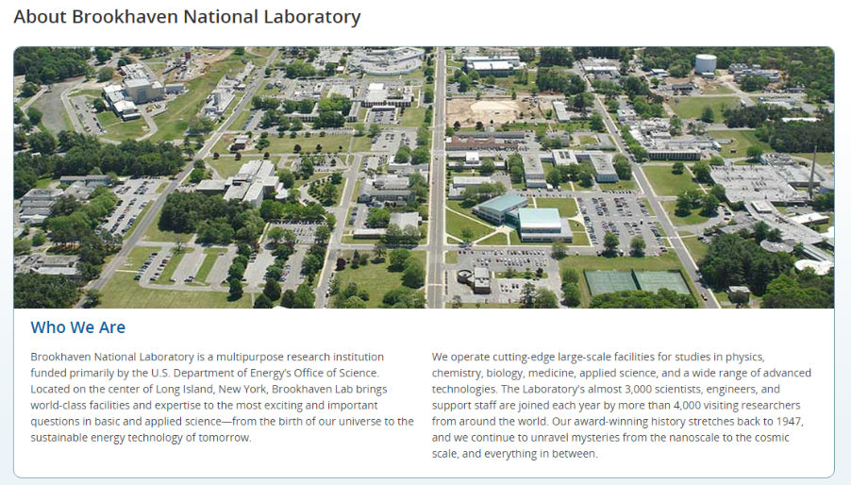

Slide 4
Agenda
The Growing Need for Scientific Computing
Differentiating CompSci vs. SciComp
Scientific Computing is the Pathway for STEM
SciComp as a Translational Science
Detailed Course Syllabus
Motivation for learning C++
Reasonable Course Expectations
Getting a Degree in Scientific Computing
Eleven “Hello” Problems

Slide 5
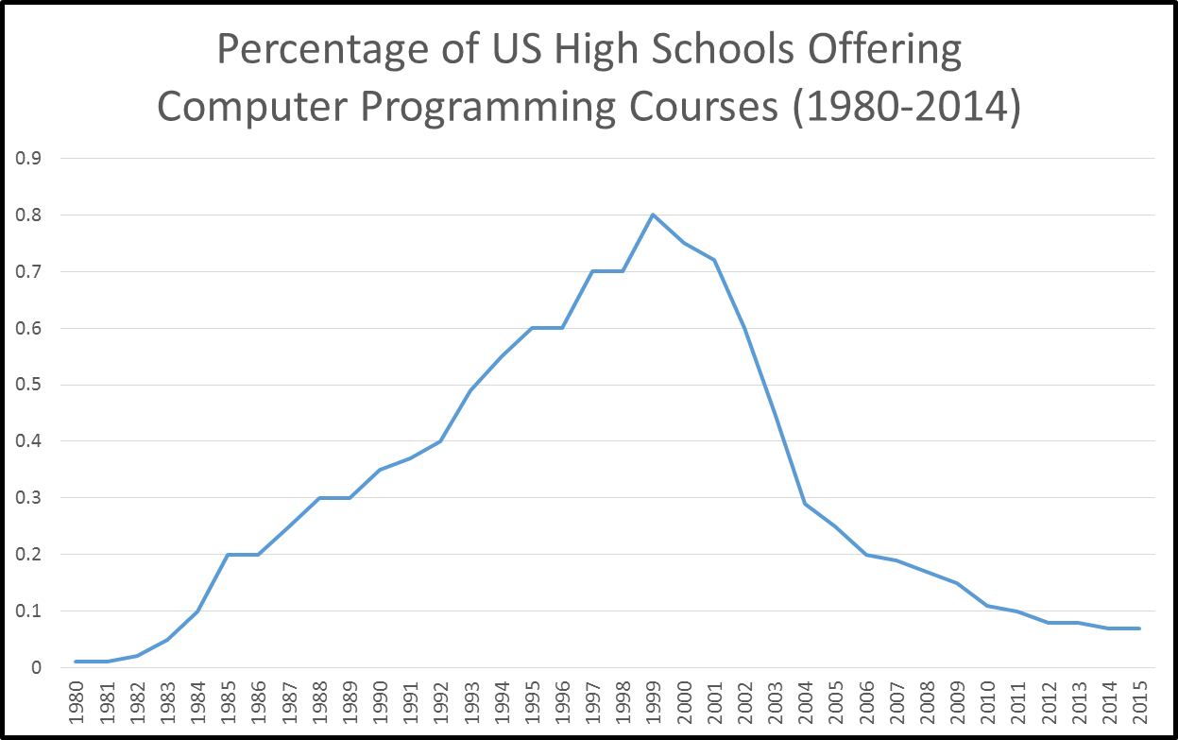
A National Challenge
2015 - National Center for Education Statistics, Dept. of Education

Slide 6
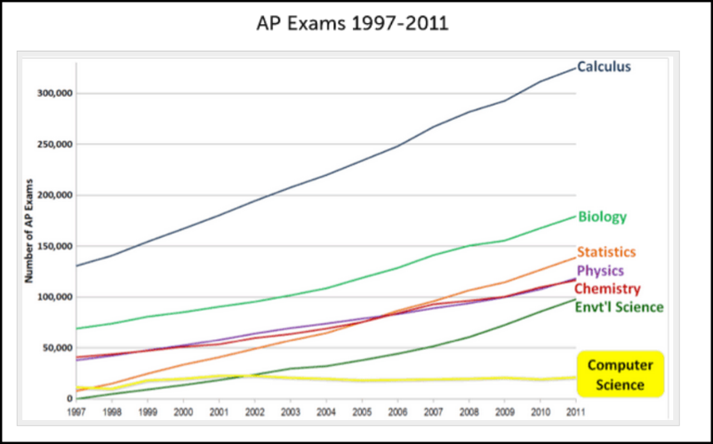
A National Challenge

Slide 7
The Challenge to DOE
Scientists across DOE have noted a dramatic rise in the startup latency of interns who do not possess foundational programming skills
This latency means that for the initial 6-8 weeks of their assignment, the interns are essentially unproductive as they must first acquire basic knowledge of how to write software
Instead of learning key scientific principles from their mentor, the interns are spending their precious lab time often working alone, figuring out how to instruct the computer to perform rudimentary data processing tasks
From the perspective of DOE scientists, the need to adeptly wield software tools has never been as urgent as it is today

Slide 8
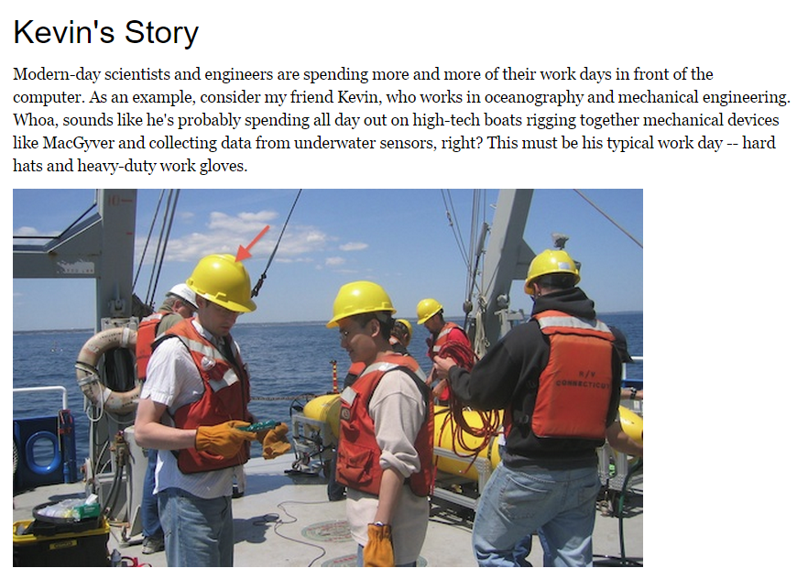
The Hype

Slide 9
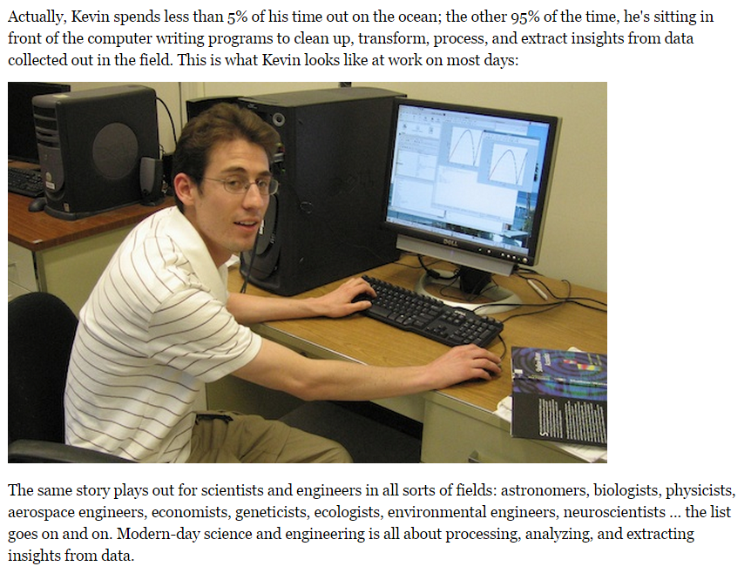
The Reality

Slide 10
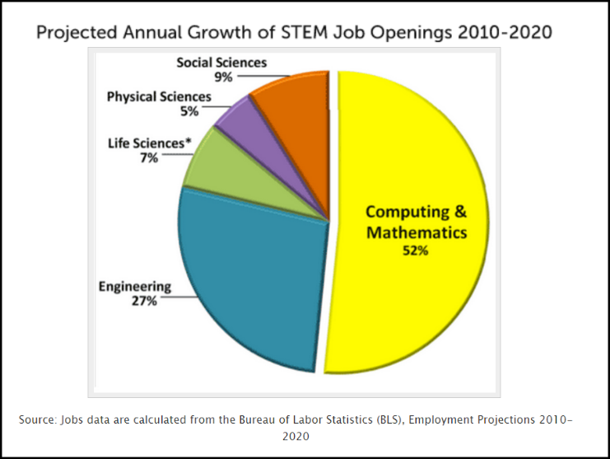
The Irony

Slide 11
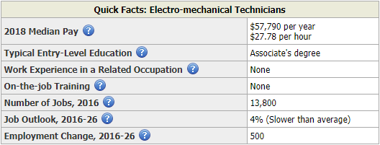
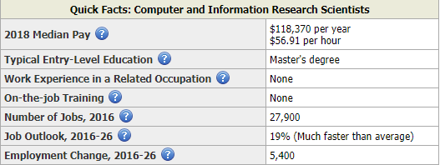
US Department of Labor - 2019
Robotics Engineering Careers
Scientific Computing Careers

Slide 12
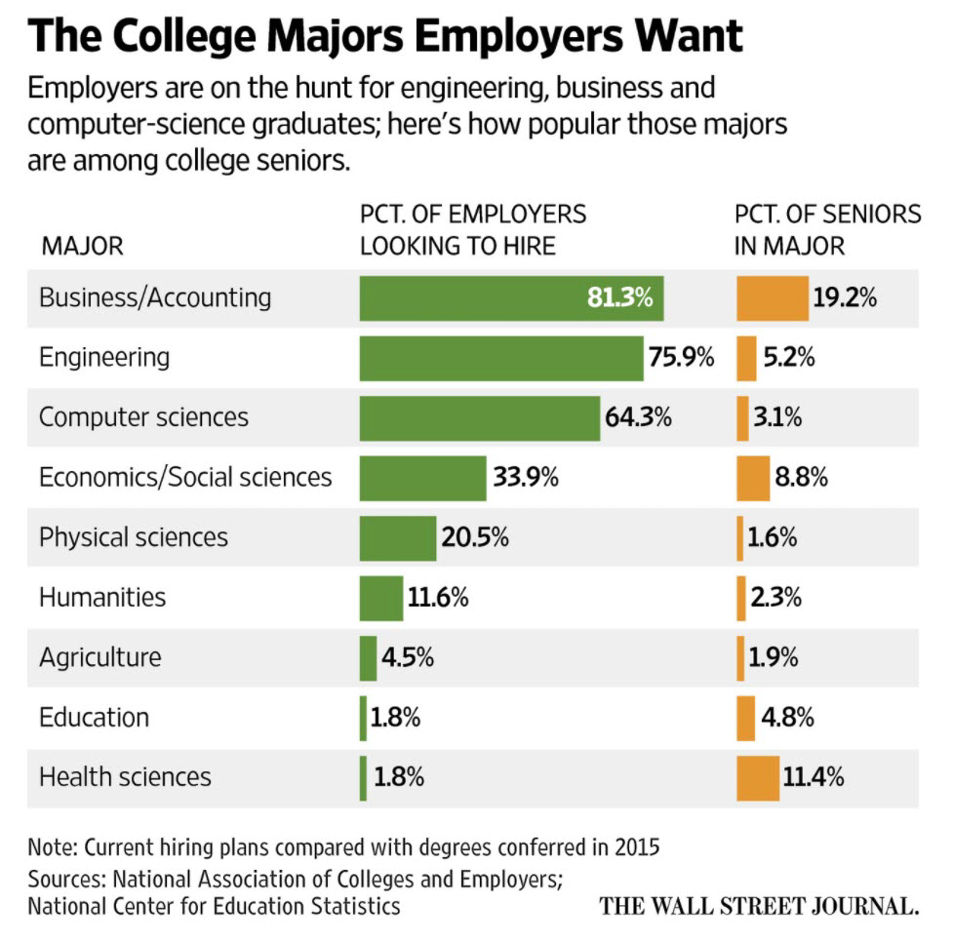

Slide 13
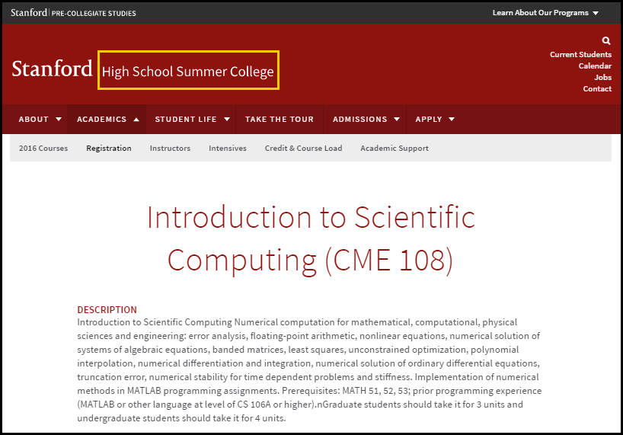

Slide 14
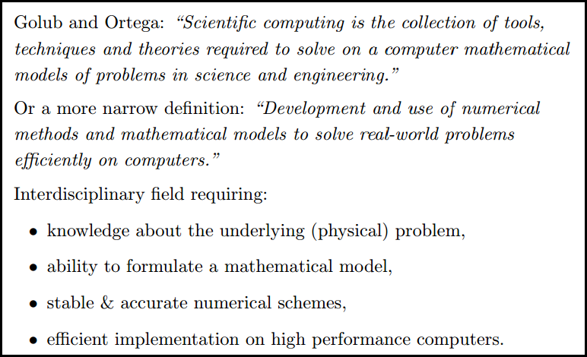

What is Scientific Computing?

Slide 15
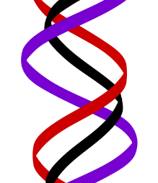
What is Scientific Computing?
Scientific computing problems cannot be solved using a graphing calculator or with Microsoft Excel
The computer should not been seen as just another closed form tool like an scientific instrument
SciComp does not require writing thousands of lines of code to answer problems – complete code usually fits on one slide!
SciComp is applied computer science
The first name of CompSci is computer
The first name of SciComp is science
A triple helix of math, science, and computing

Slide 16
SciComp vs CompSci
Scientific Computing
Computer Science
Probability and Statistics
Simulation and Modelling
Data Visualization
Storing and Analyzing Very Large Datasets
Parallel & Distributed Algorithms
Speed and Accuracy Paramount
Functional Languages
Open-Ended Problems with Unknown Solutions
General Data Structures
Design Methodologies
Procedural Languages
Stand-Alone Programs
Emphasis on Object-Orientation
Simple Data Models
Sequential Algorithms
Less Graphics Intensive
Directed Closed-Form Problems with Known Solutions

Slide 17
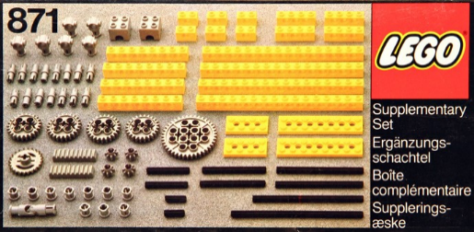
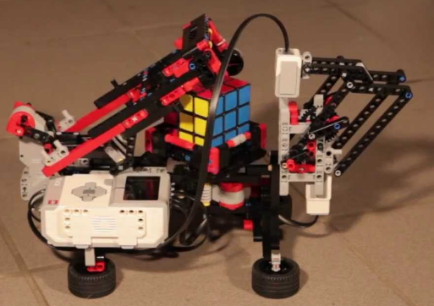
SciComp = Just Enough CompSci
Data types: int, double, bool, string
Data structures: pointers, vectors, streams, classes
Statements: for(), while(), if(), return
Patterns: brute force, recursion, divide & conquer, map-reduce
Algorithms: GCD, mean/variance, sorting, searching
Helpers: Random, mod %, Stopwatch, Allegro, ROOT

Slide 18
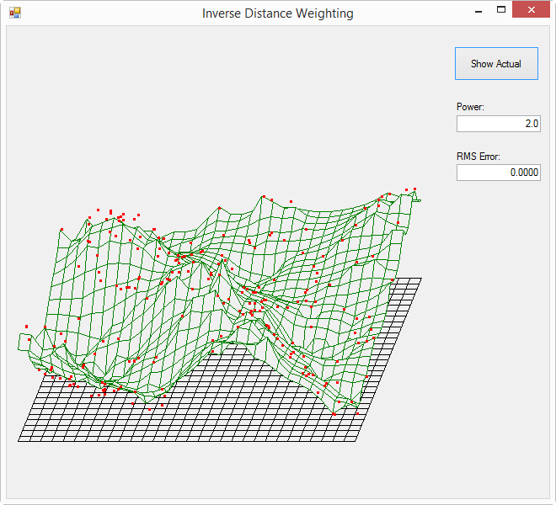
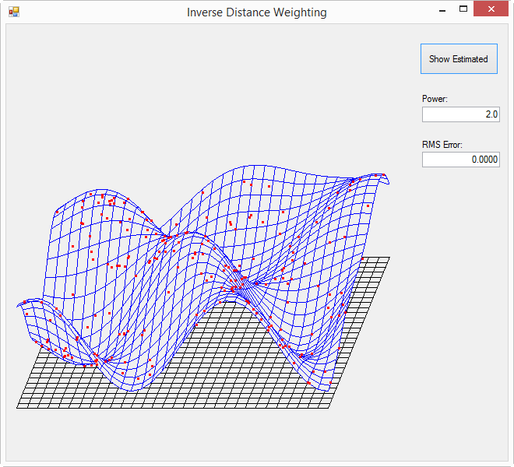
Example SciComp Topic Multidimensional Interpolation
A first order approximation having only 24%
of the world sampled (220 of 900 actual points)

Slide 19
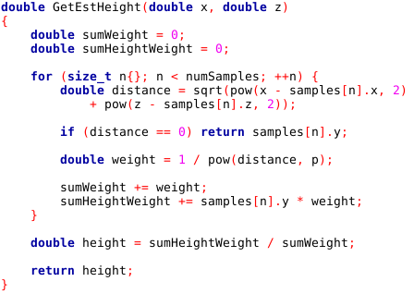
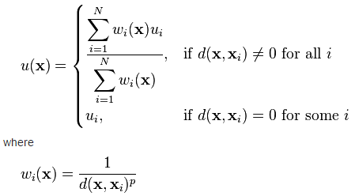
SciComp As Translational Science

Slide 20
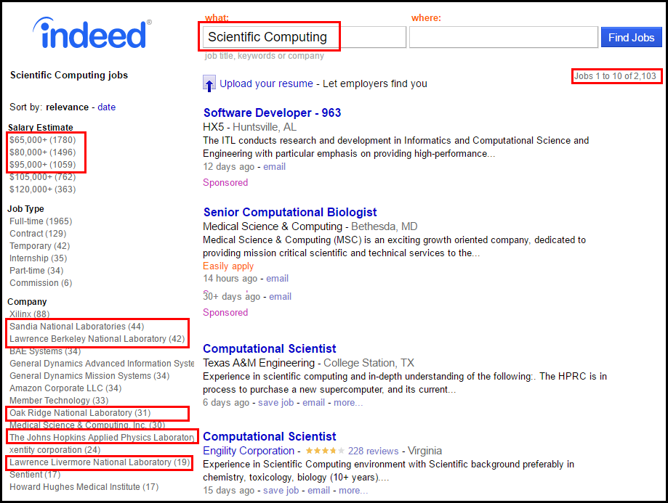
SciComp = The Pathway to Internships

Slide 21
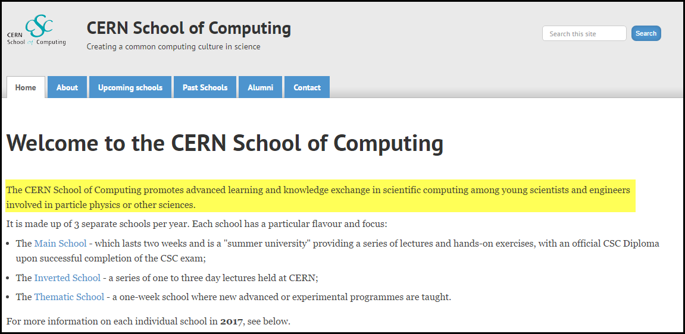
SciComp = The Pathway to Internships
At CERN, before students can even start their internships, they must pass a two week C++ course in Scientific Computing
That is how important CERN views these skills!

Slide 22
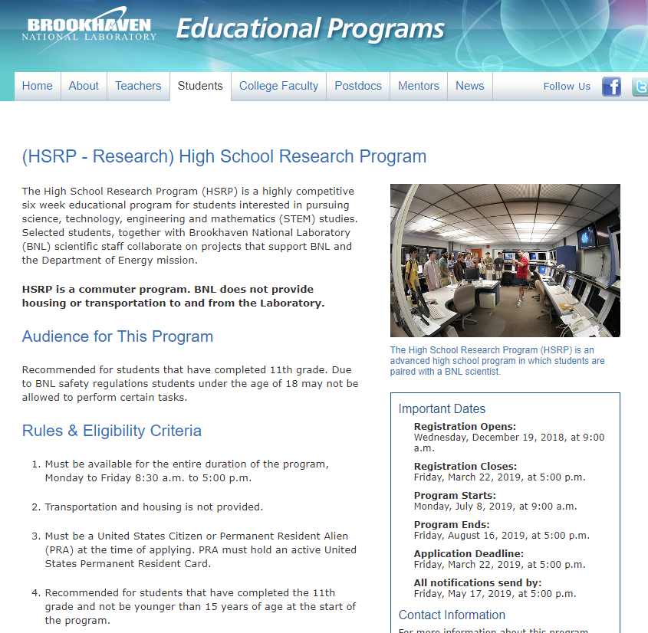

Slide 23
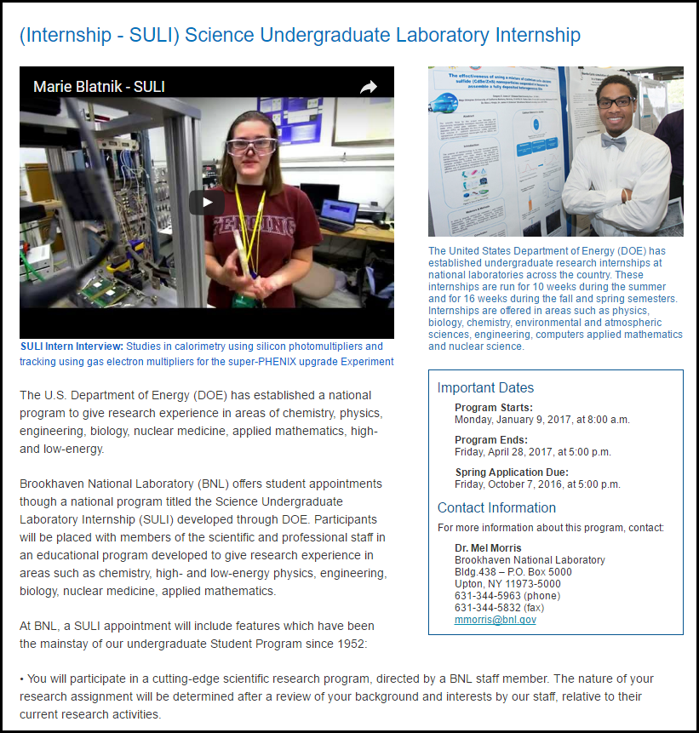

Slide 24
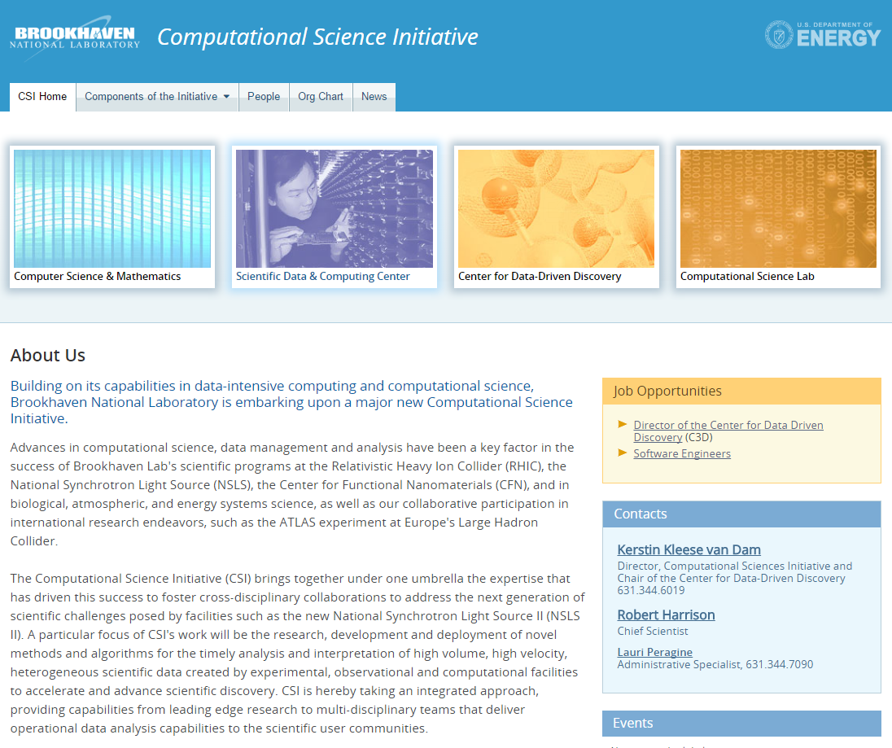

Slide 25
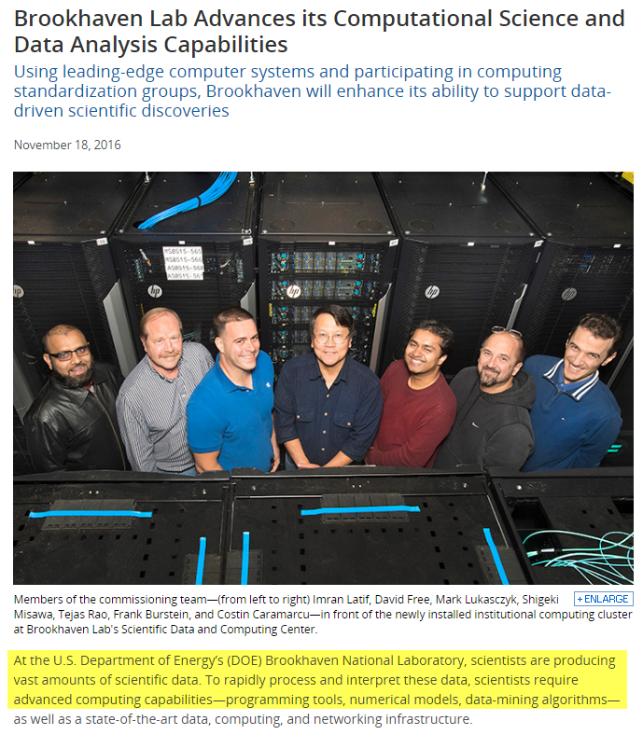

Slide 26
The Challenge Facing Educators
How to introduce SciComp into a tightly controlled preexisting science curriculum?
How to control compute resources normally owned by the Math, Engineering, or Business departments?
How to demonstrate solving science problems using code before students complete their first CompSci course?
How to address worries that writing code impairs scientific intuition or reduces the time for hands-on experiences?
How to raise the comfort level of science educators who have not written computer code in years?

Slide 27
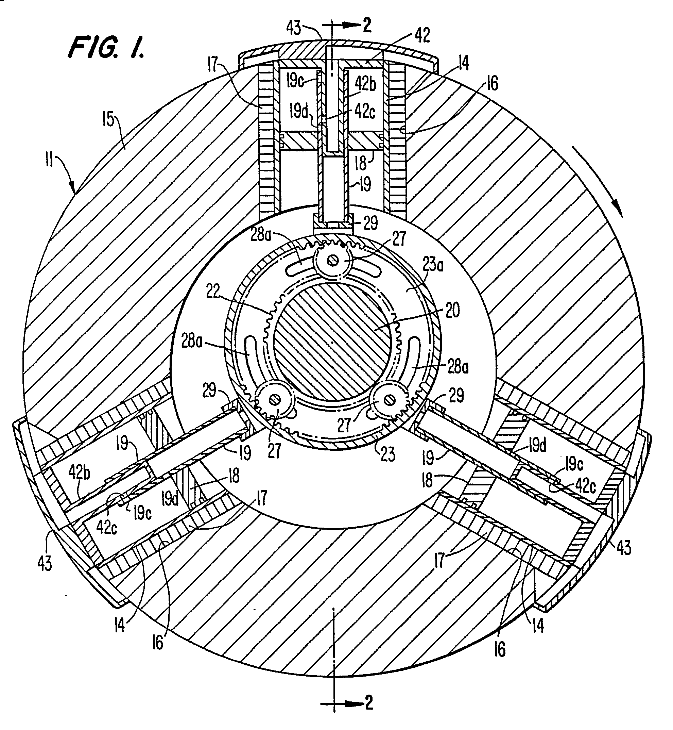
SciComp Is Getting Lost in the Middle
Science courses focus on natural laws, laboratory protocols, physical device manipulation
Math courses focus on formulae, proofs, problem solving mechanics, abstract tasks
Computer Science courses focus on theory, platforms, tools, languages, business information systems

Slide 28
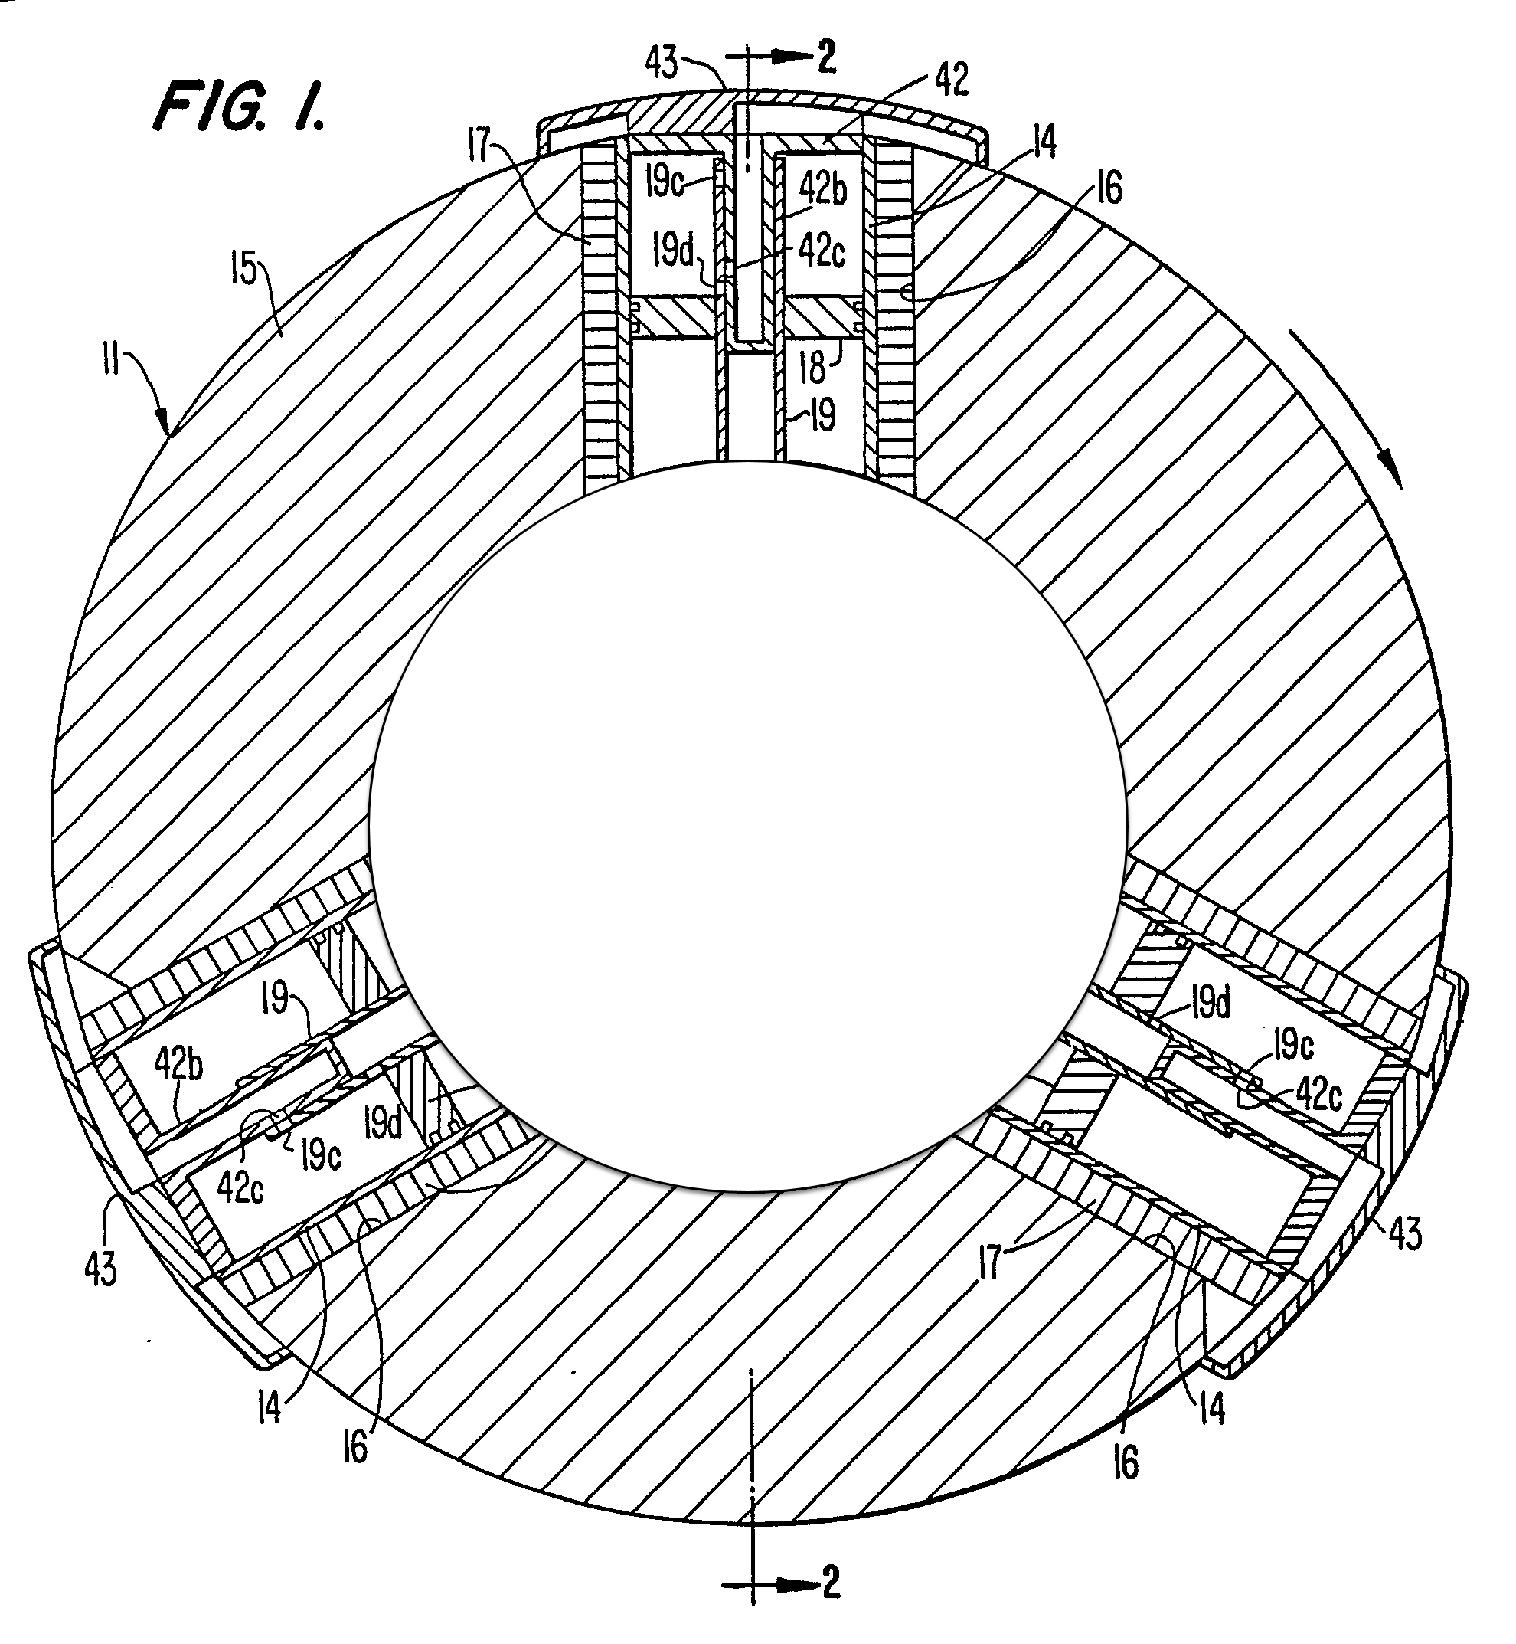
SciComp Is Getting Lost in the Middle
Science courses focus on natural laws, laboratory protocols, physical device manipulation
Math courses focus on formulae, proofs, problem solving mechanics, abstract tasks
SciComp
Historical Departmental Silos
Organizational Inertia
Instructor Readiness
Computer Science courses focus on theory, platforms, tools, languages, business information systems

Slide 29
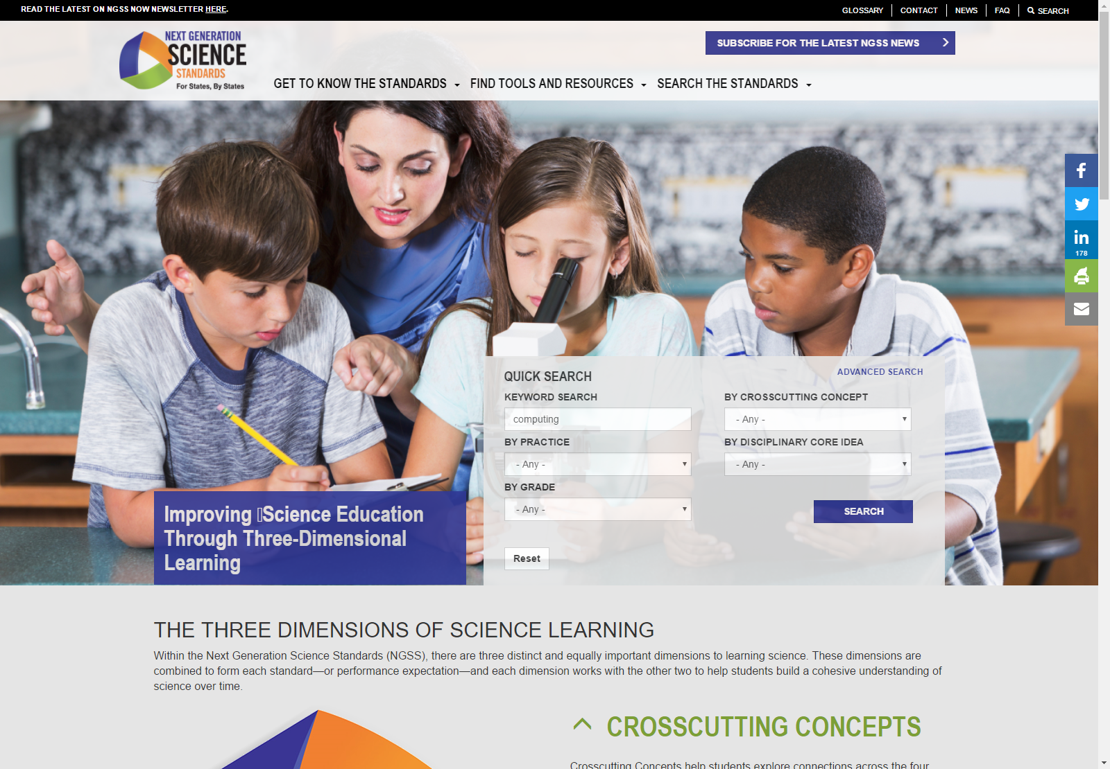
The Challenge Facing Educators
A search for
“computing”…
https://www.nextgenscience.org

Slide 30
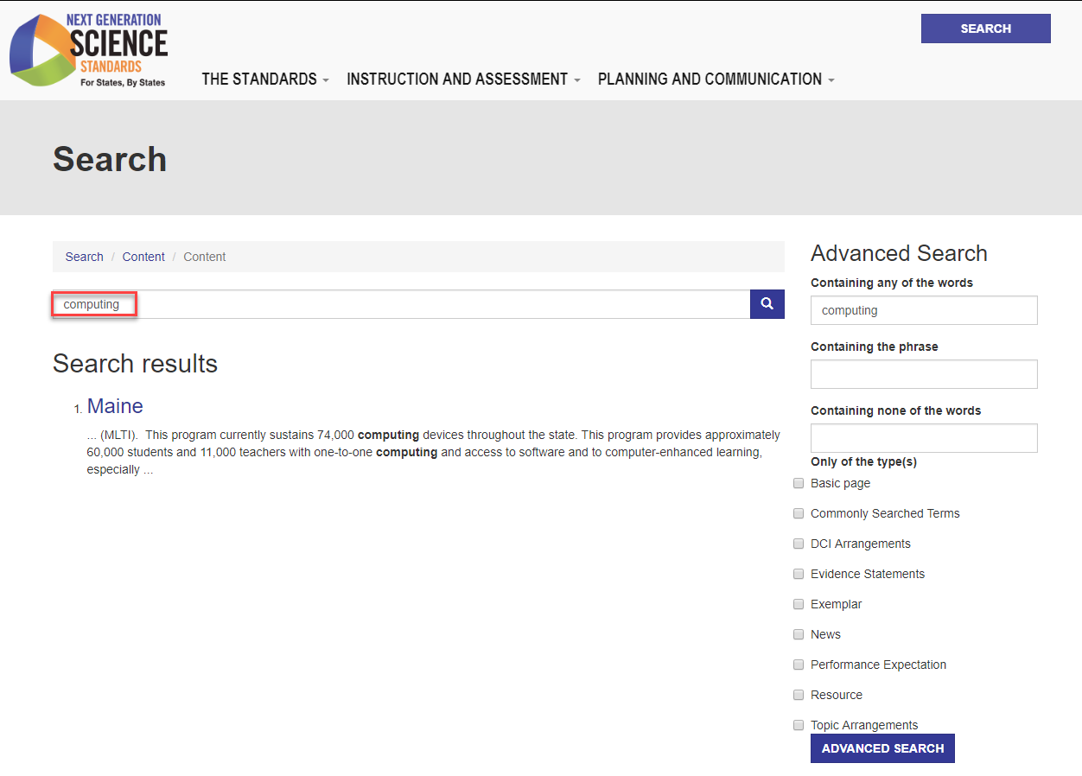
The Challenge Facing Educators
Searches for
computers…
programming…
coding…
also return nearly zero documents
A search for
“computing”
Returns only one article about rolling out computing “devices”

Slide 31
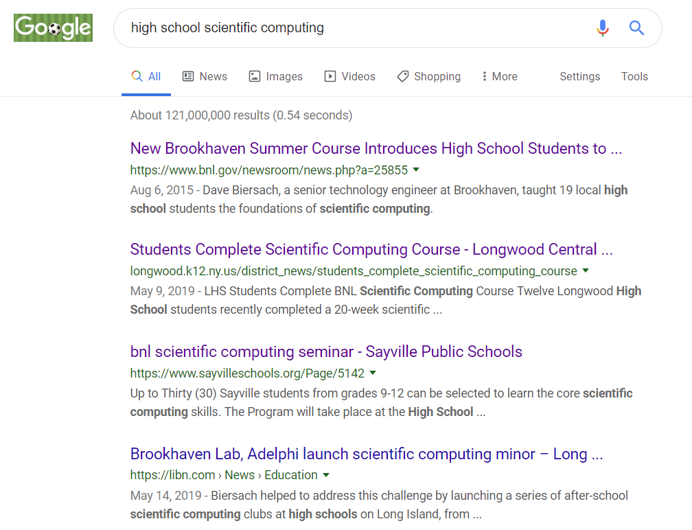
Yet you are Leading the World!
We’re the top 10 hits in Google!

Slide 32
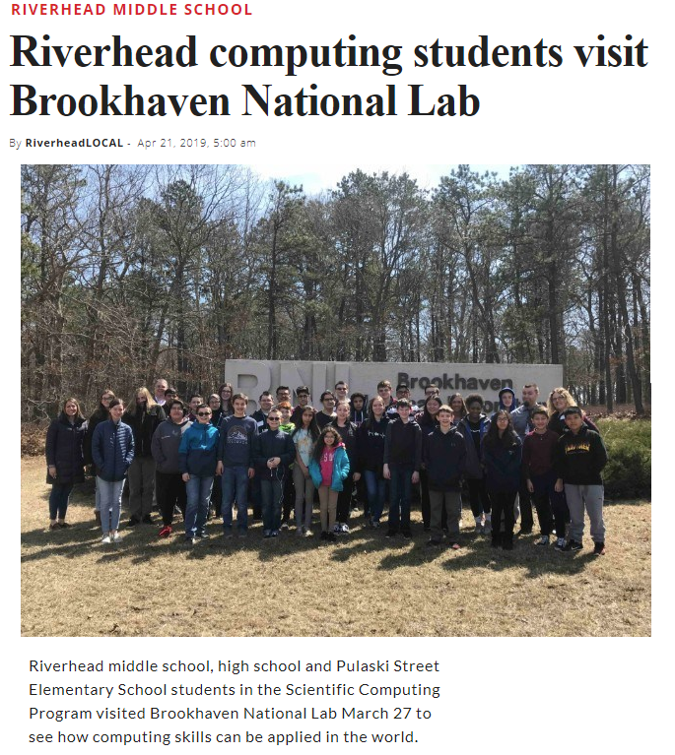
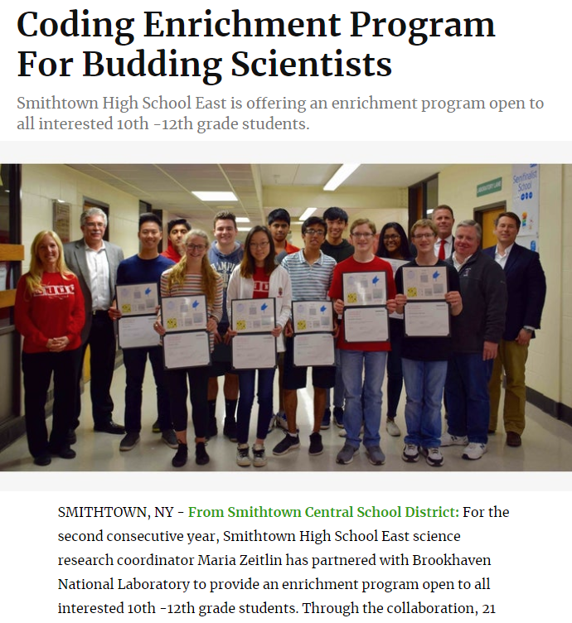
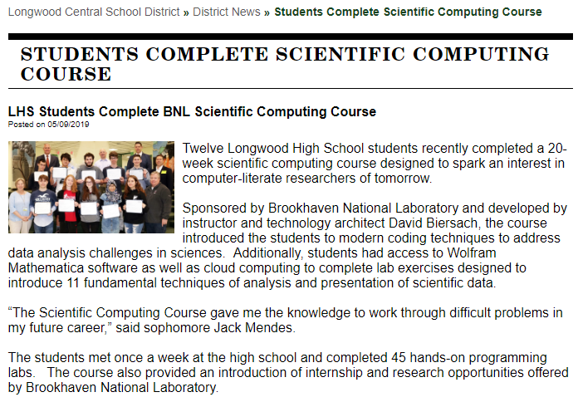

Slide 33
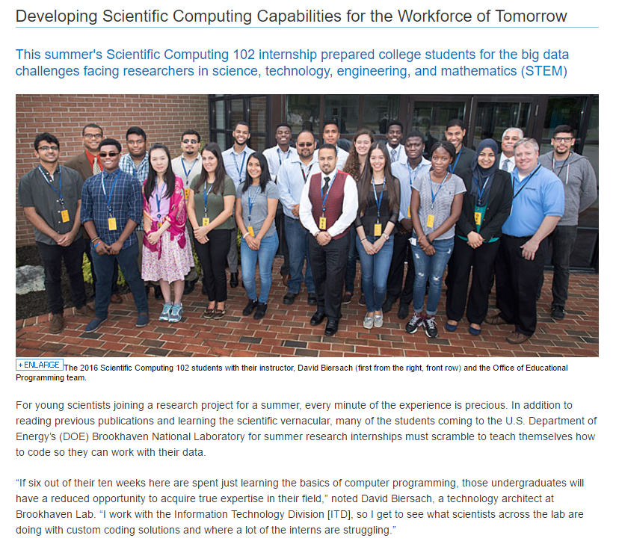

Slide 34
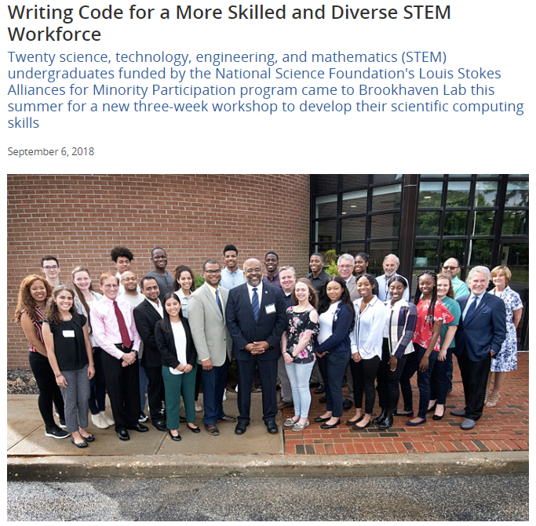
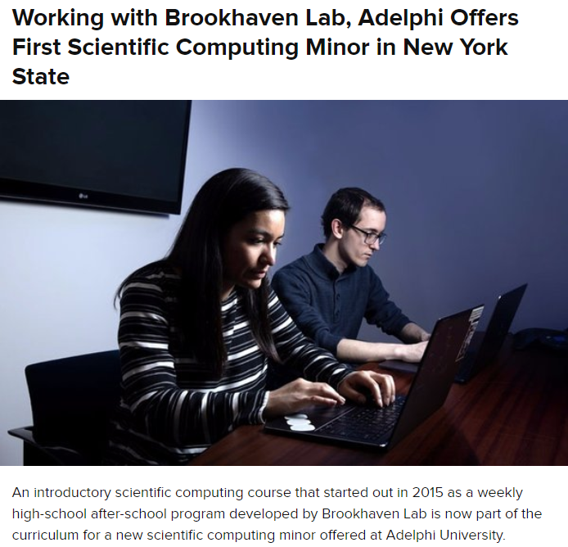

Slide 35
SciComp 301 Survey of Scientific Computing
Objectives
Provide patterns for solving real-world science problems by writing custom software
Demonstrate how scientific computing impacts all science disciplines
Enable students to translate scientific formulas into correct and efficient code
Review techniques for the effective visualization of complex data
Show optimal methods to store and analyze very large data sets
Prepare students to conduct interdisciplinary research at world-class institutions

Slide 36
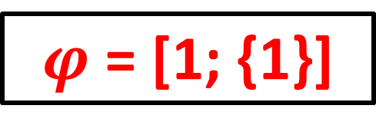
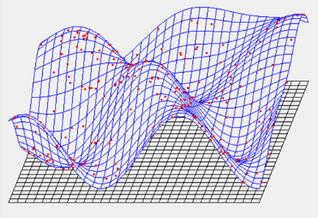
Mathematical Concepts
Systems of Equations
Probability Distributions
Combinatorics
Simulation & Modeling
Monte Carlo Integration
Polar & Spherical Coordinates
Dynamical Systems
Mesh Interpolation
2D Affine Transformations
Vector & Complex Algebra
Signals Analysis
$$\sum_{n=1}^{∞}{\frac{1}{n^{2}}=1+\frac{1}{4}+\frac{1}{9}+\frac{1}{16}+\frac{1}{25}+…=\frac{π^{2}}{6}}$$

Slide 37
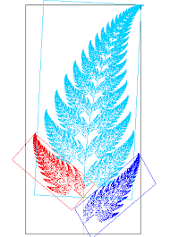
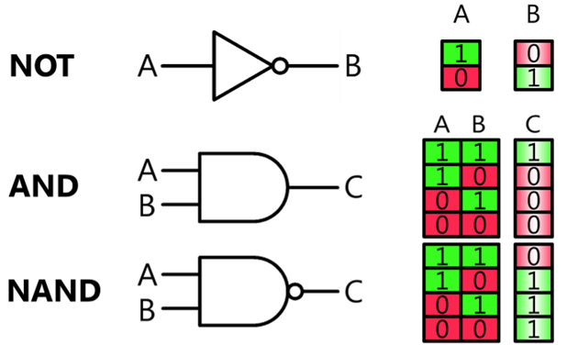
Computer Science Concepts
Representations and Encodings
Random Number Generation
Strings, Arrays, Operators
Loops, Functions, Recursion
Searching & Sorting
2D and 2.5D Graphics (Oblique Projection)
Boolean Algebra, Digital Logic Circuits
Runtime Complexity
File I/O (CSV)
CERN ROOT

Slide 38
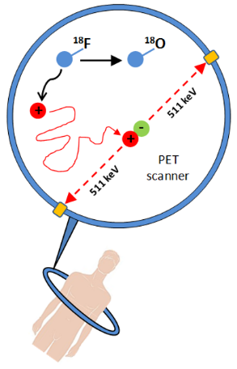
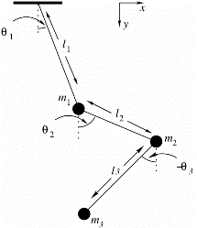
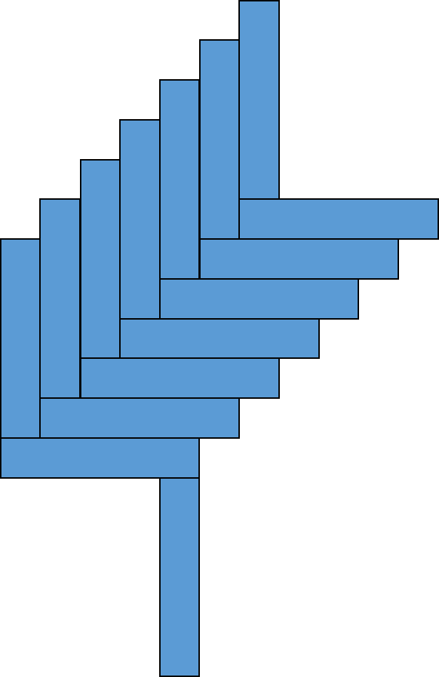
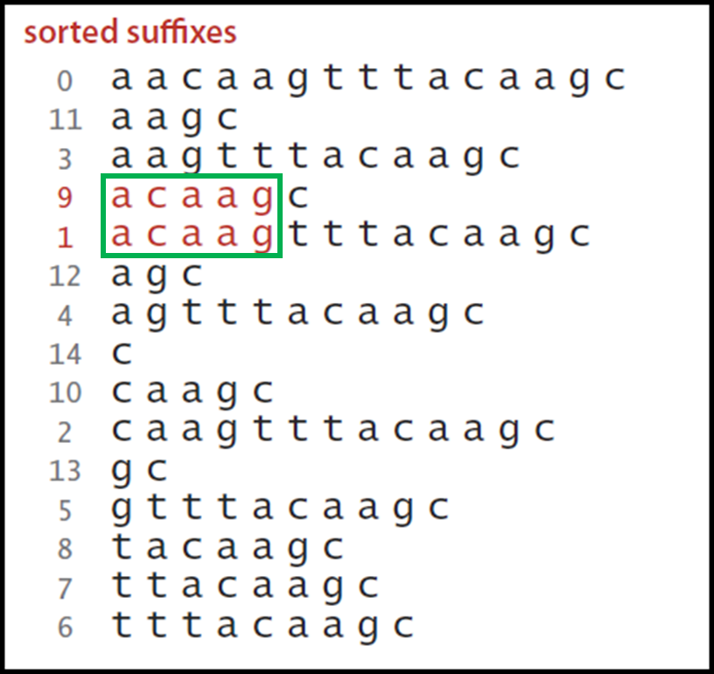
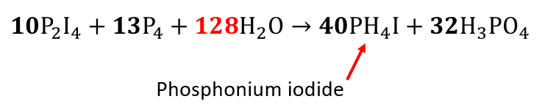
Science Concepts
Mechanics and Kinematics
Waves (Fourier Analysis)
Unit Conversion
Genetic Sequence Analysis
Balancing Ionic Equations
Projectile Motion
Equilibrium & Thermodynamics
Radioactive Decay

